Slide 1
Model Checking Hierarchical Probabilistic Systems
Jun. Sun
Singapore University of Technology and Design
Songzheng Song and Yang Liu
National University of Singapore

Slide 2
Model checking
A model covers all relevant details may not be feasible. Probability is necessary.
Randomized distributed algorithms, Bio-systems, Decision processes, Human factor in system reliability, etc.
Problem: How to verify a system with one or more random components?
Example: a pacemaker malfunctions with a probability of 0.46%.

Slide 3
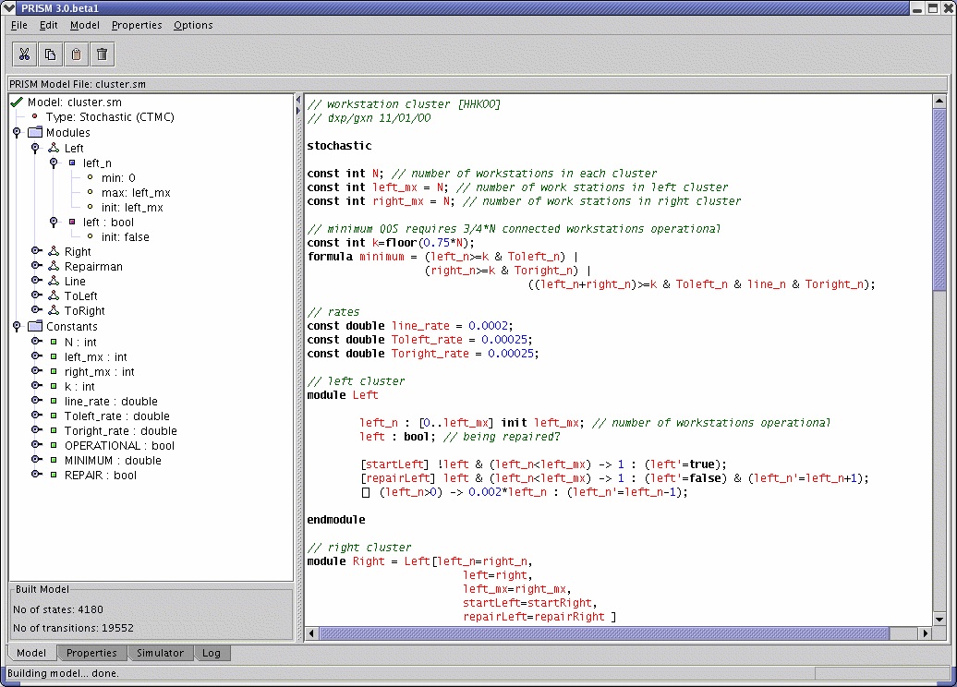
PRISM

Slide 4
PRISM’s Language
“…[a model] must be specified in the PRISM language, a simple, state-based language, based on the Reactive Modules formalism of Alur and Henzinger ...”
Example
module phil1
p1: [0..11];
[] p1=0 -> (p1'=1); // trying
[] p1=1 -> 0.5 : (p1'=2) + 0.5 : (p1'=3); // draw randomly [] p1=2 & lfree -> (p1'=4); // pick up left
[] p1=3 & rfree -> (p1'=5); // pick up right
[] p1=4 & rfree -> (p1'=8); // pick up right (got left)
…

Slide 5
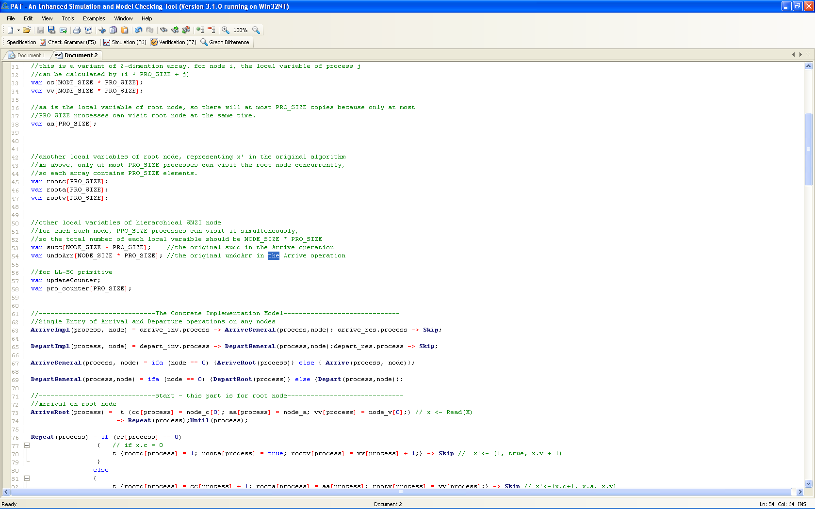
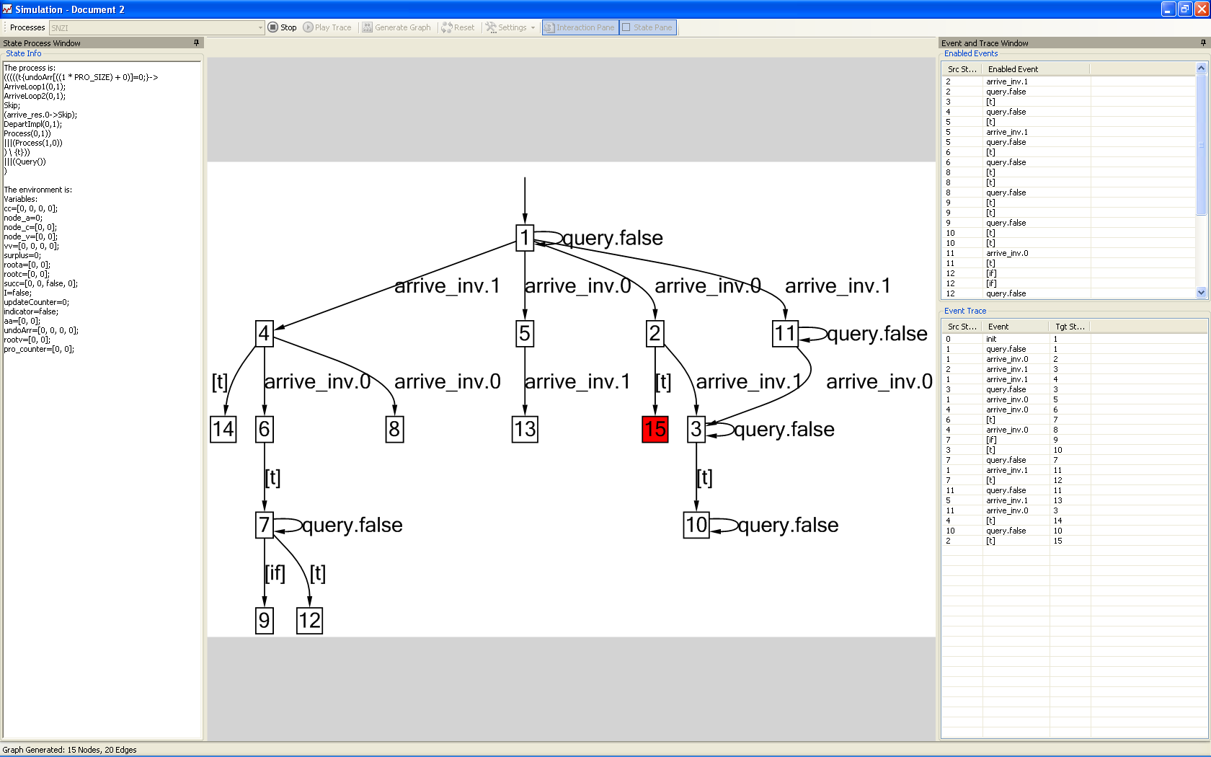
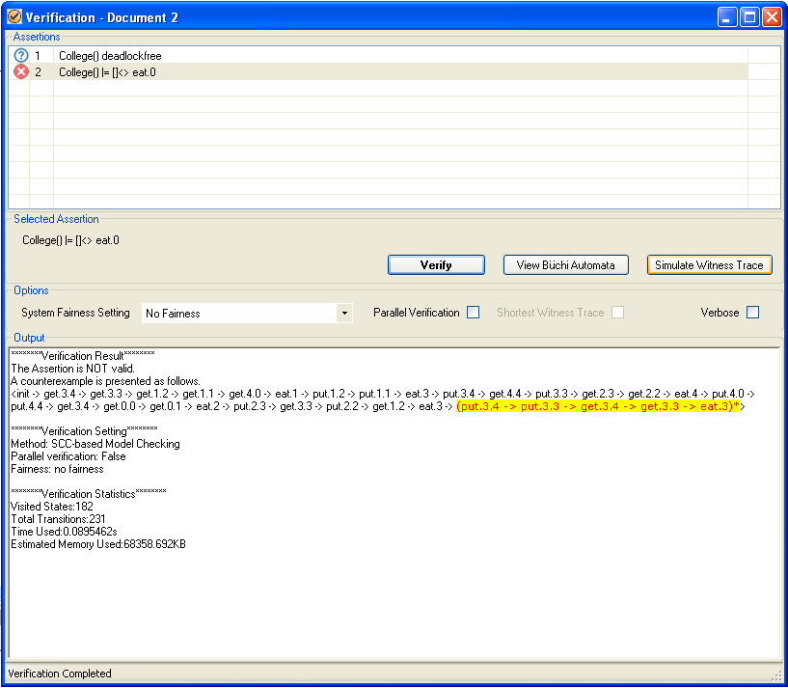
PAT

Slide 6
PAT’s Probabilistic Language
PCSP# = CSP# + PCSP =
CSP
Stop, Skip, e -> P, P [] Q, P || Q, P|[X]| Q, P; Q, etc.
+ Data Structure
e{x=y+5; z=obj.Method1(x,y,z)} -> P
+ Probabilistic Choice
pcase {
[p1]: P1; [p2]: P2; …; [pn]: Pn
}

Slide 7
PCSP# Semantics
Markov Decision Processes (MDP)
Operational Semantics: extending semantics of CSP# with one rule
-------------
(V, pcase {[p1] P1; [p2] P2; … }) →
(V, u) such that u(P1) = p1 and u(P2) = p2 and etc.
0.7
1
0.3

Slide 8
Property: Reachability
Example: what is the probability of severe consequence due to pacemaker malfunctioning?
What is the probability of reaching a bad state?
0.25
1
0.7
0.3
0.5
0.25
0.6
0.4

Slide 9
Property: Refinement
Example: What is the probability of a heart (with an installed pacemaker) behaving normally?
What is the probability of a PCSP# implementation model trace-refining a CSP# specification model?
The implementation model is the parallel composition of a model of a problematic heart and the pacemaker.
The specification model is a model of a normal heart.

Slide 10
Refinement: Algorithm
Determinize the specification model
So that a state in the determinized specification contains a set of states which can be reached via the same trace.
Compute the synchronous product of the implementation and the determinized specification
So that a state in the product is of the form (s, X) such that s is a state of implementation and X is a state of the determinized specification.
Compute the probability of reaching any state of the form (s, {}) in the product.

Slide 11
Refinement: Example
exit.1 with prob 0.9
exit.1
cs.2 with prob 0.1
cs.1
cs.1
exit.12
cs.2
cs.2
cs.1 with prob 0.2
exit.2 with prob 08
exit.2
The Implementation
The Specification

Slide 12
Property: LTL
Problem: Given an LTL formula ψ, what is probability of a PCSP# model satisfies ψ?
Automata theoretic approach
Build a deterministic Rabin automaton which is equivalent to ψ.
Build the product of the PCSP# model and the Rabin automaton.
Identify end components in the product which satisfies Rabin acceptance condition.
Compute the probability of reaching any states in the end components.

Slide 13
Improved LTL Verification
Generate Buchi Automaton from ψ
Generate Buchi Automaton from ψ
The BA is Safety
The BA is NOT Safety
Generate Buchi Automaton from -ψ
Refinement Checking
The BA is NOT Safety
Standard Probabilistic LTL Model Checking

Slide 14
Experiment
PAT vs PRISM 3.3.1
Note 1: PCSP# is capable of specifying hierarchical probabilistic system.
Note 2: The experiment is based on benchmark systems which are NOT hierarchical.
Note 3: PAT is currently based on explicit state whereas PRISM is based (MT)BDD.

Slide 15
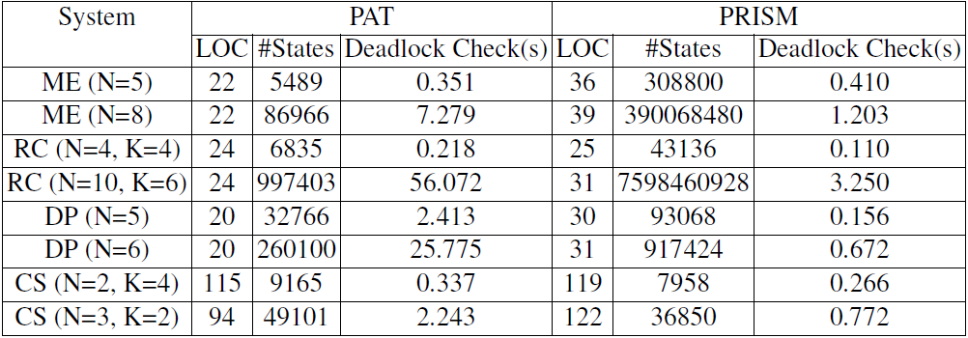
Experiment: Modeling

Slide 16
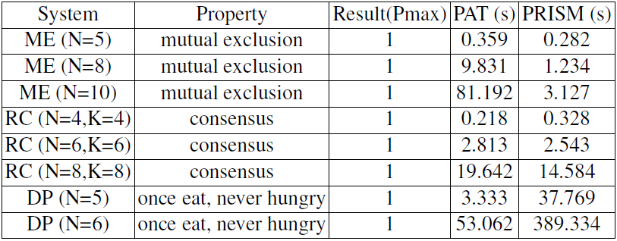
Experiment: Refinement

Slide 17
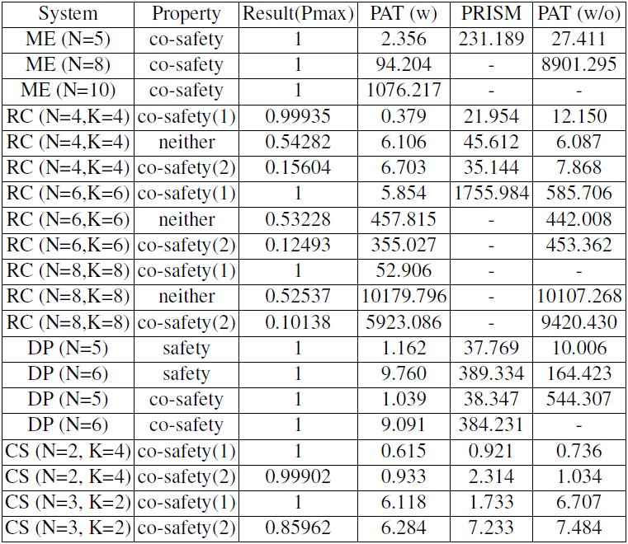
Experiment: LTL

Slide 18
Before Demonstration
Contributions
PCSP#: a language for modeling hierarchical probabilistic systems.
PAT: a reliable toolkit for probabilistic model checking.
Future work
State reduction.
PCSP# + real-time
http://www.patroot.com
The modeling language is extremely important in system verification.

